Slide 1
Repetidora GTR 8000
Notes:
Instructor Guide
1-<number>
ASTRO® 25 Trunked Integrated Voice & Data System Release 7.4 Módulo 1: GTR 8000 Repeater Site
GTR 8000 Expandable Site Subsystem

Slide 2
Objetivos
Ao final deste treinamento, você estará capacitado a:
Identificar as configurações e os componentes da Repetidora GTR 8000
Programar as funções através do CSS
Notes:
Instructor Guide
1-<number>
ASTRO® 25 Trunked Integrated Voice & Data System Release 7.4 Módulo 1: GTR 8000 Repeater Site
GTR 8000 Expandable Site Subsystem

Slide 3
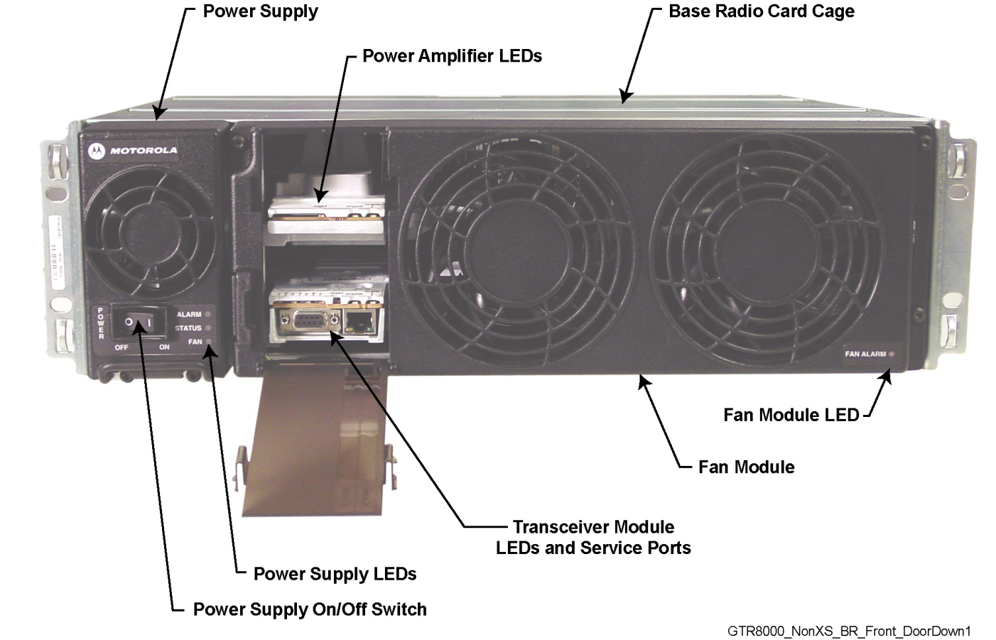
Repetidora GTR8000
Notes:
Instructor Guide
1-<number>
ASTRO® 25 Trunked Integrated Voice & Data System Release 7.4 Módulo 1: GTR 8000 Repeater Site
GTR 8000 Expandable Site Subsystem

Slide 4
Módulos da Repetidora
Os módulos da repetidora GTR 8000 são:
Transceptor (XCVR)
Amplificador de Potência
Ventilador
Fonte de Alimentação
Painel de conexão, Suporte de Placas, e Backplane
Notes:
Instructor Guide
2-<number>
ASTRO® 25 Trunked IV&D System Release 7.4 Module 4: GTR 8000 Expandable Site Subsystem
GTR 8000 Expandable Site Subsystem Workshop

Slide 5
Transceptor
Módulo Transceptor:
Placa de Controle
Placa RF
Interfaces Externas
Portas (Na frente e Atrás)
Switch
Notes:
Instructor Guide
2-<number>
ASTRO® 25 Trunked IV&D System Release 7.4 Module 4: GTR 8000 Expandable Site Subsystem
GTR 8000 Expandable Site Subsystem Workshop

Slide 6
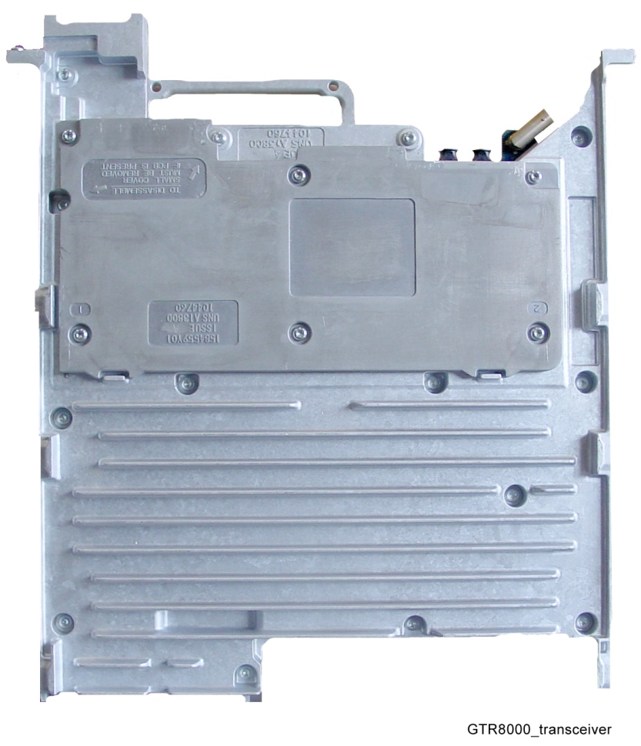
Módulo Transceptor
Proporciona as funções de controle, excitador e receptor.
O XCVR tem duas placas de circuitos:
  Placa de controle XCVR
  Placa de RF XCVR
Módulo Transceptor (XCVR) (Vista Frontal)
Notes:
Instructor Guide
2-<number>
ASTRO® 25 Trunked IV&D System Release 7.4 Module 4: GTR 8000 Expandable Site Subsystem
GTR 8000 Expandable Site Subsystem Workshop
Instructor Notes:
Suggested Teaching Strategy:
The transceptores (XCVR) module provides the controle, exciter, and receiver functions for the base rádio.
The XCVR generates the station reference, which typically needs to be locked to one of the many possible external sources.
The external source can be either the site controller TDM clocks, or the external reference operating at 5, 10, or 20 MHz.
The XCVR SPI bus allows communication with its receiver and exciter circuitry, as well as the power supply and power amplifier modules.
There are two circuit boards in the XCVR:
XCVR controle Board: Performs the controle management, digital signal processing, and transmit and receive data formatting for the base rádio.
XCVR RF Board: Contains DC power conversion/regulation, and performs receiver and exciter functions.

Slide 7
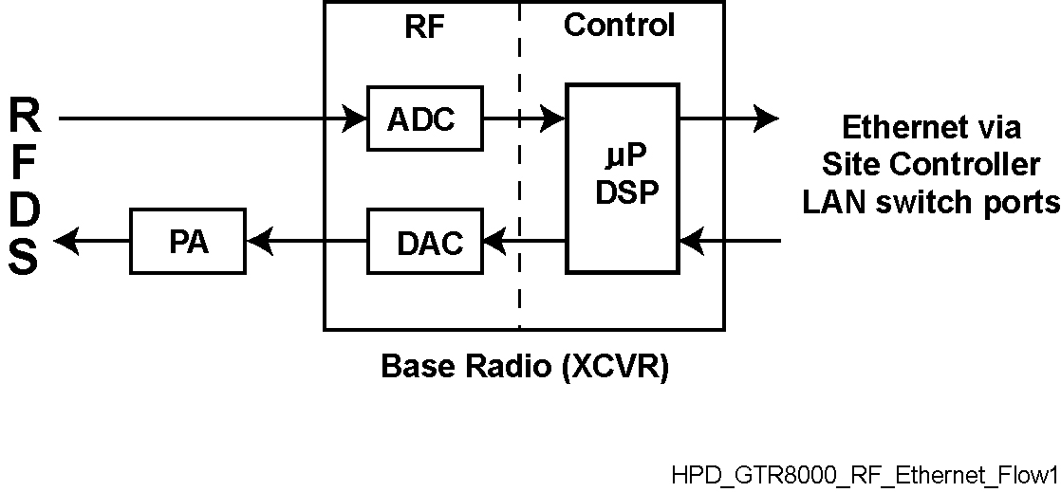
Transceptor
Ethernet através
da portas do
Controlador de sítio-Switch LAN
Rádio Base (XCVR)
Fluxo de Informação GTR 8000
Notes:
Instructor Guide
2-<number>
ASTRO® 25 Trunked IV&D System Release 7.4 Module 4: GTR 8000 Expandable Site Subsystem
GTR 8000 Expandable Site Subsystem Workshop
Instructor Notes:
The figure on the slide shows the information flow through the transceptores controle and RF sections.
The main operating software for the base rádio is loaded in the controle section of the XCVR.
As the main manager for the base rádio, the XCVR controle board provides operational controle over the other station modules.
It handles three types of information flow, in the following ways:
Serves as a gateway between the network and RF functionality, by distributing the RF payload to and from the network
Supports operational and diagnostic functions with digital controle data (for example: site information, channel assignments, and identification numbers for call processing)
Ensures the flow of other network management configuration information

Slide 8
Conexões Frontais do Transceptor
XCVR Porta/ Tipo | Conecta a este Dispositivo/Porta | Descrição
Service port, RJ-45 | PC de Serviço, porta LAN | Porta de serviço Etherner para acesso local usando CSS (Configuration Service Software). Também usado para download de software localizadas.
Service port, DB-9 | PC de Serviço, porta RS-232 | Porta de serviço serial para a configuração inicial da endereço IP da rádio base.
Notes:
Instructor Guide
2-<number>
ASTRO® 25 Trunked IV&D System Release 7.4 Module 4: GTR 8000 Expandable Site Subsystem
GTR 8000 Expandable Site Subsystem Workshop
Instructor Notes:
The transceptores external interfaces include seven external ports, a switch, and LEDs.
Two ports are accessible through a dropdown door to the left of the fans.
An asynchronous port, synchronous port, and a reference frequency input alignment port are located behind the fan module.

Slide 9
Funções do Switch Frontal do Transceptor
Ação do Usuário | Resultado
Pressione o switch por menos de 1 segundo | Acesso Desabilitado
Pressione o switch por mais de 3 segundos | Reinício do Módulo de controle do Transceptor
Notes:
Instructor Guide
2-<number>
ASTRO® 25 Trunked IV&D System Release 7.4 Module 4: GTR 8000 Expandable Site Subsystem
GTR 8000 Expandable Site Subsystem Workshop
Instructor Notes:
There is one multifunction switch on the front of the transceptores module, accessible through the dropdown door to the left of the fans.
Use light pressure when pressing the reset button

Slide 10
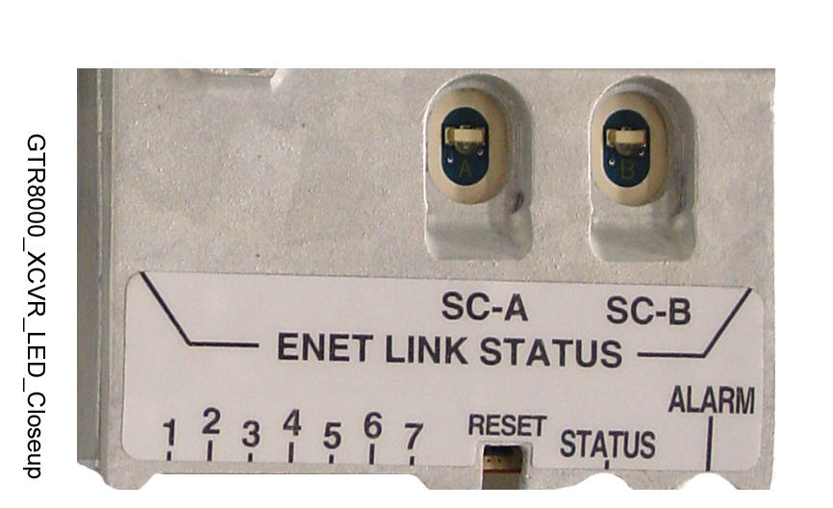
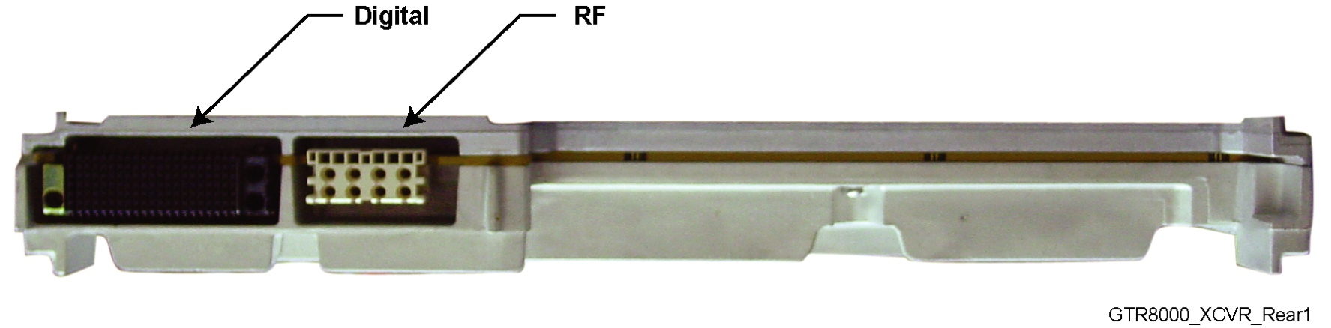
Transceptor
Botão de Reset GTR 8000
Módulo Transceptor GTR 8000 (Conexões do Backplane)
Notes:
Instructor Guide
2-<number>
ASTRO® 25 Trunked IV&D System Release 7.4 Module 4: GTR 8000 Expandable Site Subsystem
GTR 8000 Expandable Site Subsystem Workshop
Instructor Notes:
The transceptores interconnects to the backplane using a 120–pin HVDML digital connector and 8–pack RF connector.
These connections handle multiple signals including power, power supply communications, power amplifier communications, fan interface, and peripheral interface.
The digital connection receives alarm data and the TDM signals from the site controller, which are used to pass reference and controle data to the station.
In the expandable site subsystem configuration, the site controller and transceptores connect directly through a common backplane. The backplane connects the transceptores’s RF inputs with the associated receive multicouplers (Cabinet RMCs/LNAs).

Slide 11
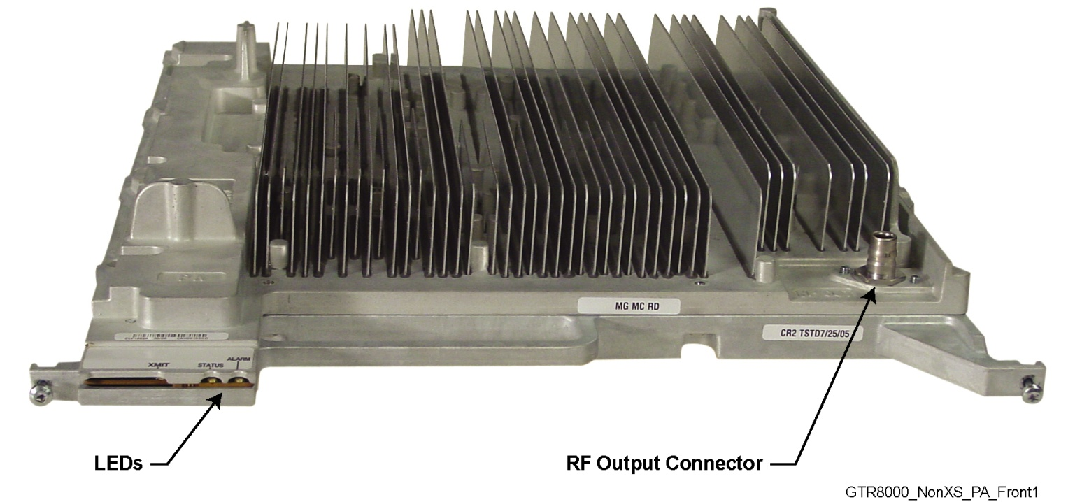
Módulo de Amplificador de Potência
Amplificador de Potência de RF com resfriamento forçado de convecção
Tem seis módulos internos
Notes:
Instructor Guide
2-<number>
ASTRO® 25 Trunked IV&D System Release 7.4 Module 4: GTR 8000 Expandable Site Subsystem
GTR 8000 Expandable Site Subsystem Workshop
Instructor Notes:
Suggested Teaching Strategy:
Explain the functions of the Power Amplifier (PA).
The power amplifier is a forced convection-cooled RF power amplifier.
It accepts a low-level modulated RF signal from the transceptores module, and amplifies it for transmission through the site transmit antenna.
In order to complete the Cartesian correction loop (GTR 8000’s linearization method), it provides a low level RF feedback signal to the transceptores module, to achieve the required transmitter linearity.
Transmit power output can be set using Configuration/Service Software (CSS).
The power amplifier also performs functions related to the fan module, including reporting of fan module status and supplying power to the fan power bus.

Slide 12
Amplificador de Potência
Módulos do Amplificador de Potência:
Placa Central
Placa Conversora
Placa Amplificadora de Condução
Placa Amplificadora Final
Placa de Distribuição
Circuito de Saída
Notes:
Instructor Guide
2-<number>
ASTRO® 25 Trunked IV&D System Release 7.4 Module 4: GTR 8000 Expandable Site Subsystem
GTR 8000 Expandable Site Subsystem Workshop
Instructor Notes:
Explain the six internal modules of the power amplifier on the next slides:
Core Board
Converter Board
Driver Amplifier Board
Final Amplifier Board
Distribution Board
Output Circuitry

Slide 13
Placa central do Amplificador de Potência
A placa central fornece:
Memória Não-volátil para armazenar informação de ajuste
Ganho e controle de Potência FB
Sensores de Diagnóstico
Interface digital até o resto da Rádio Base
Medidas de controle de resfriamento
LEDs de Estados
Notes:
Instructor Guide
2-<number>
ASTRO® 25 Trunked IV&D System Release 7.4 Module 4: GTR 8000 Expandable Site Subsystem
GTR 8000 Expandable Site Subsystem Workshop

Slide 14
Placa Conversora do Amplificador de Potência
A placa Conversora de Potência fornece:
Ajuste do nível de tensão para a segunda etapa de ganho RF
Diagnósticos do monitor de tensão
Notes:
Instructor Guide
2-<number>
ASTRO® 25 Trunked IV&D System Release 7.4 Module 4: GTR 8000 Expandable Site Subsystem
GTR 8000 Expandable Site Subsystem Workshop
Instructor Notes:
The Power Converter Board is used to adjust the voltage level supplied to the second RF gain stage of the final module to increase the efficiency of the power amplifier, reduce power consumption, and increase power amplifier longevity by allowing lower operating temperatures.
The Power Converter Board also provides voltage monitoring diagnostics.

Slide 15
Placa Amplificadora de Condução do Amplificador de Potência
A Placa Amplificadora de Condução fornece:
As primeiras duas etapas de amplificação de RF
Compensação de Ganho sobre temperatura
Ajuste DC na Placa
Funcionalidade de backup do transmissor
Notes:
Instructor Guide
2-<number>
ASTRO® 25 Trunked IV&D System Release 7.4 Module 4: GTR 8000 Expandable Site Subsystem
GTR 8000 Expandable Site Subsystem Workshop
Instructor Notes:
The Driver Amplifier Board provides the first two stages of RF amplification within the Power Amplifier (PA).
It accepts the output RF signal from the transceptores module (through the core board) and amplifies it to an intermediate power level.
The Driver Amplifier Board also provides:
Gain compensation over temperature
On-board DC regulation
Transmitter standby functionality

Slide 16
Placa de amplificação Final do Amplificador de Potência
A placa de Amplificação Final do Amplificador de Potência fornece :
Últimas dos etapas de amplificação RF
Divisão de potência RF (2-vías)
Combinação de potência RF (2-vías)
Diagnósticos
Funcionalidade de backup do transmissor
Notes:
Instructor Guide
2-<number>
ASTRO® 25 Trunked IV&D System Release 7.4 Module 4: GTR 8000 Expandable Site Subsystem
GTR 8000 Expandable Site Subsystem Workshop

Slide 17
Placa de Distribuição do Amplificador de Potência
A placa de Distribuição fornece:
Roteamento da potência DC e RF dentro do PA
Roteamento de sinal DC.
Notes:
Instructor Guide
2-<number>
ASTRO® 25 Trunked IV&D System Release 7.4 Module 4: GTR 8000 Expandable Site Subsystem
GTR 8000 Expandable Site Subsystem Workshop

Slide 18
Circuito de Saída do Amplificador de Potência
O Módulo de Saída fornece:
Isolação da saída através da atenuação de intermodulação
Atenuação Harmônica
Detecção de potência direta e reversa
Notes:
Instructor Guide
2-<number>
ASTRO® 25 Trunked IV&D System Release 7.4 Module 4: GTR 8000 Expandable Site Subsystem
GTR 8000 Expandable Site Subsystem Workshop
Instructor Notes:
Output Isolation through Intermodulation Attenuation (IMA): This is needed due to the inevitable back feeding of other site transmitter signals into the power amplifier. It provides proper RF loading to the final module output regardless of what load is presented at the output of the power amplifier. Additionally, it dissipates any reflected power caused by load mismatches at the power amplifier’s output.
Harmonic Attenuation: Reduces harmonic power levels conducted through the power amplifier RF output connector to acceptable levels.
Forward and Reverse Power Detection: Samples a portion of the output power (forward and reverse) to modulation independent detector circuitry. The output of the detectors are then sent to the controle board to determine the output power and operating Voltage Standing Wave Ratio (VSWR).

Slide 19
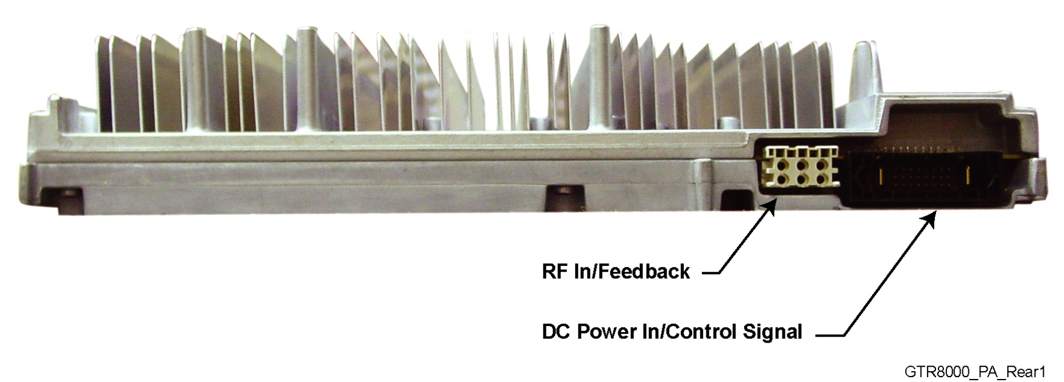
Entrada/Saída - Amplificador de Potência
Amplificador de Potência GTR 8000 (Conexões do Backplane)
Notes:
Instructor Guide
2-<number>
ASTRO® 25 Trunked IV&D System Release 7.4 Module 4: GTR 8000 Expandable Site Subsystem
GTR 8000 Expandable Site Subsystem Workshop
Instructor Notes:
There are three electrical connection assemblies on the power amplifier:
RF output (front QN “quick-N” connector) on the front of the power amplifier module
DC power supply/controle signal (backplane connection)
RF input/feedback (backplane connection)
In expandable site subsystem configurations, this is cabled to the RFDS combiner transmit connector.

Slide 20
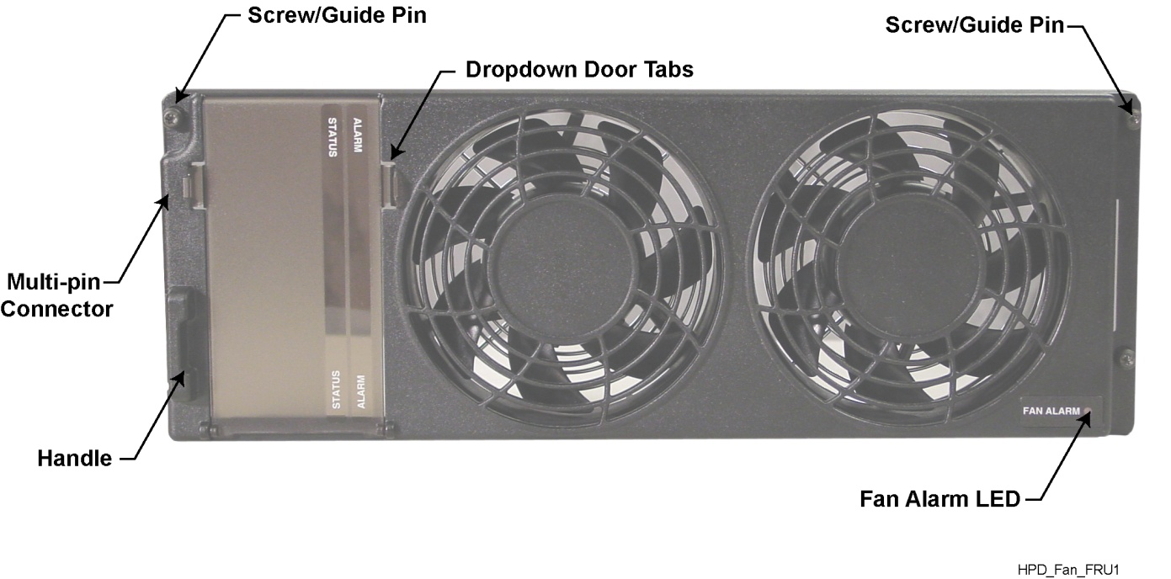
Módulo de Ventilação
Fornece o resfriamento do ar forçado contínuo para o amplificador de potência, os transceptores e os módulos de controle do sítio.
Se conecta ao backplane através de uma porta de 4–pinos
Notes:
Instructor Guide
2-<number>
ASTRO® 25 Trunked IV&D System Release 7.4 Module 4: GTR 8000 Expandable Site Subsystem
GTR 8000 Expandable Site Subsystem Workshop
Instructor Notes:
The fan module provides continuous forced air cooling for the power amplifier, transceptores, and site controller modules.
The fan module houses two 119 mm axial fans, which deliver a total of approximately 160 cubic feet per minute of airflow.
Nominal fan speed is 4100 revolutions per minute. Each fan has a built-in speed sensor, which will turn on the red Fan Alarm LED if fan speed for either fan falls 30% below the rated speed.
The fan module connects to the base rádio backplane through a 4–pin port on the front of the base rádio chassis.
The power supply module has its own fan, which provides independent airflow.

Slide 21
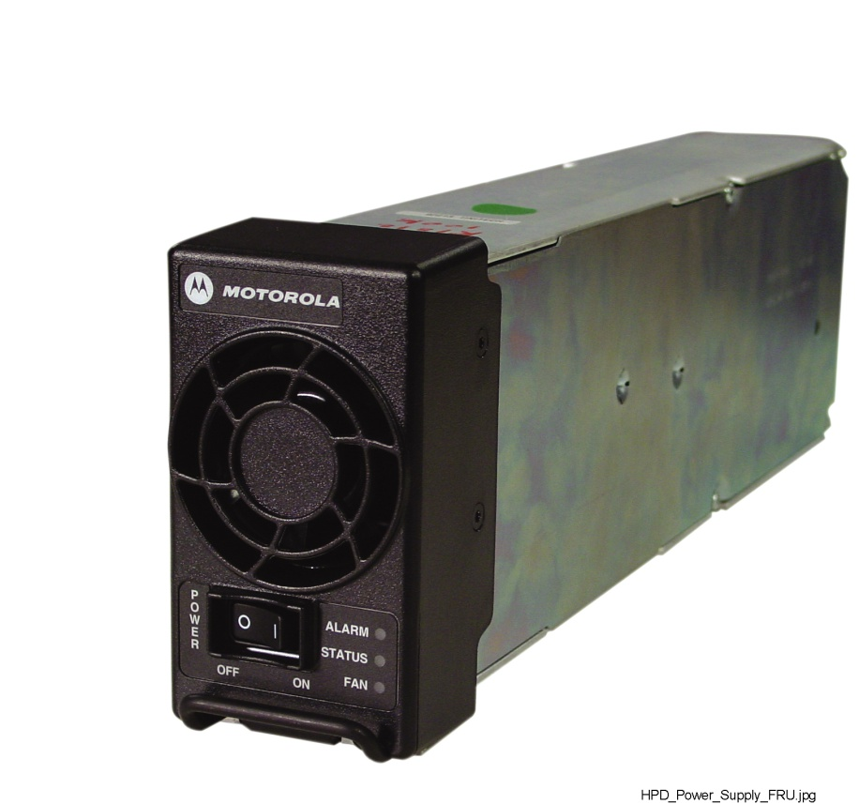
Fonte de Alimentação
Potência AC o DC
Gera todas as tensões requeridas pelos demais módulos
Notes:
Instructor Guide
2-<number>
ASTRO® 25 Trunked IV&D System Release 7.4 Module 4: GTR 8000 Expandable Site Subsystem
GTR 8000 Expandable Site Subsystem Workshop
Instructor Notes:
The GTR 8000 power supply operates from either an AC or DC input and provides the DC operating voltage for the base rádio.
When operating from an AC source (90 VAC to 264 VAC, 47Hz to 63 Hz), the supply generates two DC output voltages of 29 V with respect to the output ground.
The power supply automatically adjusts to AC input ranges and supplies a steady output.
In AC mode, the power supply provides a separate battery charger, which can be used to maintain the charge on a 48 VDC nominal system, positive or negative ground, if installed.
The supply generates two DC output voltages of 29 V with reference to output ground, when operating from a DC source (43.2 VDC to 60 VDC maximum, positive or negative ground).
Includes low voltage battery disconnect.
Float and equalization modes are available.
The power supply supports várious battery types, as selected in the Customer Service Software.

Slide 22
Fonte de Alimentação
A fonte de alimentação GTR 8000 contém:
Circuitos para a correção do fator de potência
Circuitos para a carga de baterias.
Circuitos para o diagnóstico e monitoramento
Notes:
Instructor Guide
2-<number>
ASTRO® 25 Trunked IV&D System Release 7.4 Module 4: GTR 8000 Expandable Site Subsystem
GTR 8000 Expandable Site Subsystem Workshop
Instructor Notes:
The power supply contains several switching-type power supply circuits as mentioned in this slide.
The battery charger outputs of the power supply are designed to be bussed together so that, up to six power supplies can provide charging services to a single battery bank.
The power supply controls its own continuously running fan, changing its speed to fast or slow as needed.

Slide 23
Software de Configuração
Os parâmetros configurados com CSS para a Rádio Base:
Nome da Rádio Base
Número da Rádio Base
Endereço IP da Rádio Base
Potência de Transmissão de saída
Nível de Potência de Transmissão para o backup de Baterias
Tipo de Baterias
Notes:
Instructor Guide
2-<number>
ASTRO® 25 Trunked IV&D System Release 7.4 Module 4: GTR 8000 Expandable Site Subsystem
GTR 8000 Expandable Site Subsystem Workshop
Instructor Notes:
The programming consists of two sets of parameters: device-owned parameters and manager-owned parameters. Device-owned parameters are programmed using CSS, and include these listed in the slide.
The device-owned parameters are not overwritten with values in the ZCM.
Manager-owned parameters (marked with an asterisk (*) in CSS) are programmed in the ZCM and downloaded to the base rádios when the link is established between the GCP 8000 Site Controller and the zone controller .
Manager-owned parameters can be programmed or changed locally at the base rádio using CSS, but the values are overwritten by values from ZCM after the link is established to the zone controller .
All site parameters can be programmed locally when the site is installed but, not yet linked to the zone controller . The ability to program locally provides the means to test the site prior to making it available for system operation.

Slide 24
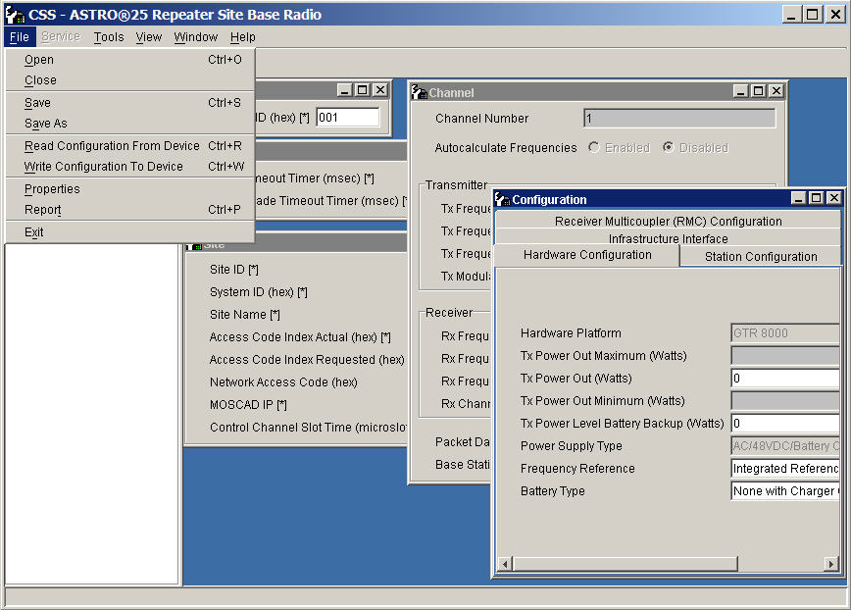
Configuração da Rádio Base Usando o CSS 192.168.1.1 porta de rede frontal
Notes:
Instructor Guide
2-<number>
ASTRO® 25 Trunked IV&D System Release 7.4 Module 4: GTR 8000 Expandable Site Subsystem
GTR 8000 Expandable Site Subsystem Workshop
Instructor Notes:
Suggested Teaching Strategy:
This slide shows the Rádio Configuration windows in CSS.

Slide 25
LEDs
LEDs Indicadores para GTR 8000:
Lamp Test
Failure
Impaired
Booting Up
Online
GTR 8000 Expandable Site Subsystem - Chapter 10: GTR 8000 Expandable Site Subsystem Reference
Notes:
Instructor Guide
2-<number>
ASTRO® 25 Trunked IV&D System Release 7.4 Module 4: GTR 8000 Expandable Site Subsystem
GTR 8000 Expandable Site Subsystem Workshop
Instructor Notes:
Many of the LEDs on GTR 8000 Base Rádio devices provide an indication for one or more of the following conditions:
Lamp Test: Verifies that the indicators are operational. For LampTest, the LEDs stay in this state for only a second or less.
Failure: Indicates a failure that can only be fixed through replacement. If something other than a hardware fault is causing the state, Impaired is indicated
Impaired: Indicates that the device is not fully operational due to internal or external causes. Some corrective action must be taken to get back to 100% operation.
Booting Up: Indicates that the device is not in service due to running of diagnostics or initializing.
Online: Indicates that the device is fully operational.
The LEDs for the site controller, transceptores, and power amplifier modules can be viewed through the door (opened or closed) to the left of the fans.

Slide 26
Transceptor
LEDs do Transceptor GTR 8000 para os módulos que tem LEDs
Notes:
Instructor Guide
2-<number>
ASTRO® 25 Trunked IV&D System Release 7.4 Module 4: GTR 8000 Expandable Site Subsystem
GTR 8000 Expandable Site Subsystem Workshop

Slide 27
Condições de LEDs de Estados e Alarmes do Transceptor
Condição | Verde (LED de Estado) | Vermelho (Led de Alarme)
No Power | Off | Off
Lamp Test | On | On
Failure | Off | On
Impaired | On | Blinking
Booting Up | Off | Off
Online | On | Off
Notes:
Instructor Guide
2-<number>
ASTRO® 25 Trunked IV&D System Release 7.4 Module 4: GTR 8000 Expandable Site Subsystem
GTR 8000 Expandable Site Subsystem Workshop
Instructor Notes:
The Status LED is Verde, and the Alarm LED is red.
These LEDs are either off or on, depending on the condition of the transceptores.

Slide 28
LEDs de Estado do Enlace do Transceptor
Condição | LED Estado do Enlace
Enlace Inativo | Off
Enlace Estabelecido | Verde
Enlace Ativo | Âmbar
Notes:
Instructor Guide
2-<number>
ASTRO® 25 Trunked IV&D System Release 7.4 Module 4: GTR 8000 Expandable Site Subsystem
GTR 8000 Expandable Site Subsystem Workshop
Instructor Notes:
The Status LEDs are either off, Verde, or Âmbar depending on the condition of the link connection between the transceptores and site controller A or B.

Slide 29
Descrição: LEDs Rádio Base
Notes:
Instructor Guide
1-<number>
ASTRO® 25 Trunked Integrated Voice & Data System Release 7.4 Módulo 1: GTR 8000 Repeater Site
GTR 8000 Expandable Site Subsystem

Slide 30
LEDs das Condições do Software de controle do Transceptor
Condição | LED 1 | LED 2 | LED 3 | LED 4
Iniciando*
Teste de Leds | Âmbar | Âmbar | Âmbar | Âmbar
Receptor Inibido | Âmbar (piscando)
Receptor Ativo | Verde
Portadora Ilegal | Vermelho (piscando)
Canal de Controle (Operando) |  | Verde
Canal de controle (Failsoft) |  | Verde (piscando)
* Durante uma seqüência normal de inicialização, LEDs 1 ao 4 piscam da esquerda para direita e da direita para a esquerda continuamente por vários segundos.
Notes:
Instructor Guide
2-<number>
ASTRO® 25 Trunked IV&D System Release 7.4 Module 4: GTR 8000 Expandable Site Subsystem
GTR 8000 Expandable Site Subsystem Workshop
Instructor Notes:
The LEDs can be green, red, or Amber depending on the condition of the transceptores.

Slide 31
LEDs das Condições do Software de Controle do Transceptor
Condição | LED 1 | LED 2 | LED 3 | LED 4
Modo de Serviço |  |  | Âmbar
Transmissor Inibido |  |  | Âmbar (piscando)
Enlace para a Infra-estrutura Conectado |  |  |  | Verde
Enlace para a Infra-estrutura Desconectado |  |  |  | Verde (piscando)
Notes:
Instructor Guide
2-<number>
ASTRO® 25 Trunked IV&D System Release 7.4 Module 4: GTR 8000 Expandable Site Subsystem
GTR 8000 Expandable Site Subsystem Workshop

Slide 32
LEDs das Condições do Software de controle do Transceptor
Condição | LED 5 | LED 6 | LED 7
Teste de Leds | Âmbar | Âmbar | Âmbar
SWDL (Transferência de Software em progresso) | Verde
Alerta |  | Âmbar
Falha Minoritária de Hardware |  | Âmbar (piscando)
Falha Majoritária de Hardware |  | Vermelho (piscando)
Falha Crítica de Hardware |  | Vermelho
Notes:
Instructor Guide
2-<number>
ASTRO® 25 Trunked IV&D System Release 7.4 Module 4: GTR 8000 Expandable Site Subsystem
GTR 8000 Expandable Site Subsystem Workshop
Instructor Notes:
The color of all LEDs must be observed in order to interpret the condition of the transceptores.
For example:
If LED 5 is Verde, the condition is “Software download transfer in progress.”
If LED 6 is red, the condition is “Critical Hardware Failure.”

Slide 33
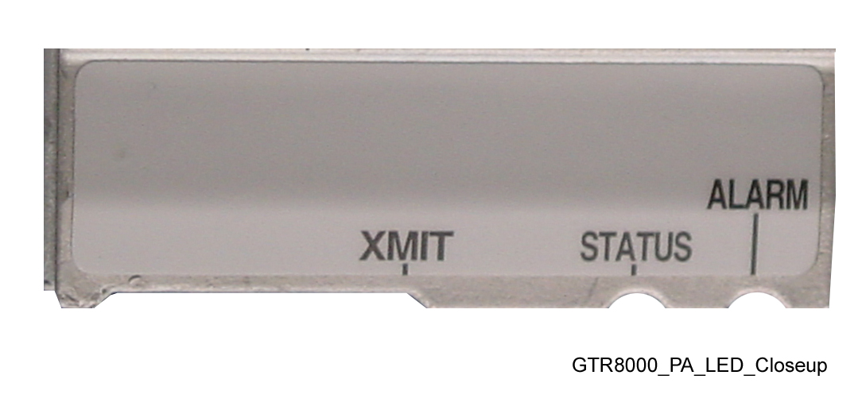
Amplificador de Potência
LEDs do Amplificador de Potência GTR 8000
Notes:
Instructor Guide
2-<number>
ASTRO® 25 Trunked IV&D System Release 7.4 Module 4: GTR 8000 Expandable Site Subsystem
GTR 8000 Expandable Site Subsystem Workshop
Instructor Notes:
The color of all the LEDs of the power amplifier must be observed in order to interpret the power amplifier’s condition.
For example:
If the Alarm LED is red and the Transmit and Status LEDs are Verde, the condition is “Lamp Test.”
If the Alarm LED is red and the Transmit and Status LEDs are not lit, the condition is “PA Failure”, and the power amplifier module should be replaced.

Slide 34
Condições dos LEDs de Amplificador de Potência
Condição | Transmissor (XMIT) | Estado | Alarmes
Sem Potência
Teste de Leds | Verde | Verde | Vermelho
Sem transmissão |  | Verde
Transmitindo a Potência de Saída Máxima Requerida | Verde | Verde
Transmitindo abaixo da Potência Requerida | Verde (piscando) | Verde
Falha de PA |  |  | Vermelho
Notes:
Instructor Guide
2-<number>
ASTRO® 25 Trunked IV&D System Release 7.4 Module 4: GTR 8000 Expandable Site Subsystem
GTR 8000 Expandable Site Subsystem Workshop

Slide 35

Módulo de Ventilação
O LED de Alarmes do Módulo de Ventilação GTR 8000
está no canto inferior direito
Notes:
Instructor Guide
2-<number>
ASTRO® 25 Trunked IV&D System Release 7.4 Module 4: GTR 8000 Expandable Site Subsystem
GTR 8000 Expandable Site Subsystem Workshop
Instructor Notes:
The fan module has one “Fan Alarm” LED visible on the lower right corner of its front panel.
The alarm is red during Lamp Test (for a second or less), and remains red if there is a fan failure.
A fan failure alarm occurs if the built-in speed sensor detects that either fan is operating 30% below rated speed.
A red fan alarm indicates that the fan module needs to be replaced within seven days.
Note: The base rádio operates at full capability for at least seven days after the fan alarm first occurs. This feature allows the system to operate normally without requiring an immediate service call.

Slide 36
Condições do LED do Módulo de Ventilação
Condição do LED | Alarme | Explicação de Estado
Off |  | Operacional ou desligado
Vermelho (por um segundo ou menos) | Vermelho | Teste de Leds
Vermelho (Constante) | Vermelho | Falha Se o sensor de velocidade interno detecta que quaisquer dos ventiladores está operando 30% abaixo da velocidade especificada. Necessita ser substituído nos próximos 7 dias.
Notes:
Instructor Guide
2-<number>
ASTRO® 25 Trunked IV&D System Release 7.4 Module 4: GTR 8000 Expandable Site Subsystem
GTR 8000 Expandable Site Subsystem Workshop
Instructor Notes:
Table in the slide explains the possible colors of the LED and what they mean.
The fan module has one LED, the Fan Alarm, located on the front in the corner.
The LED provides a visual image of the operating condition of the fan assembly.

Slide 37
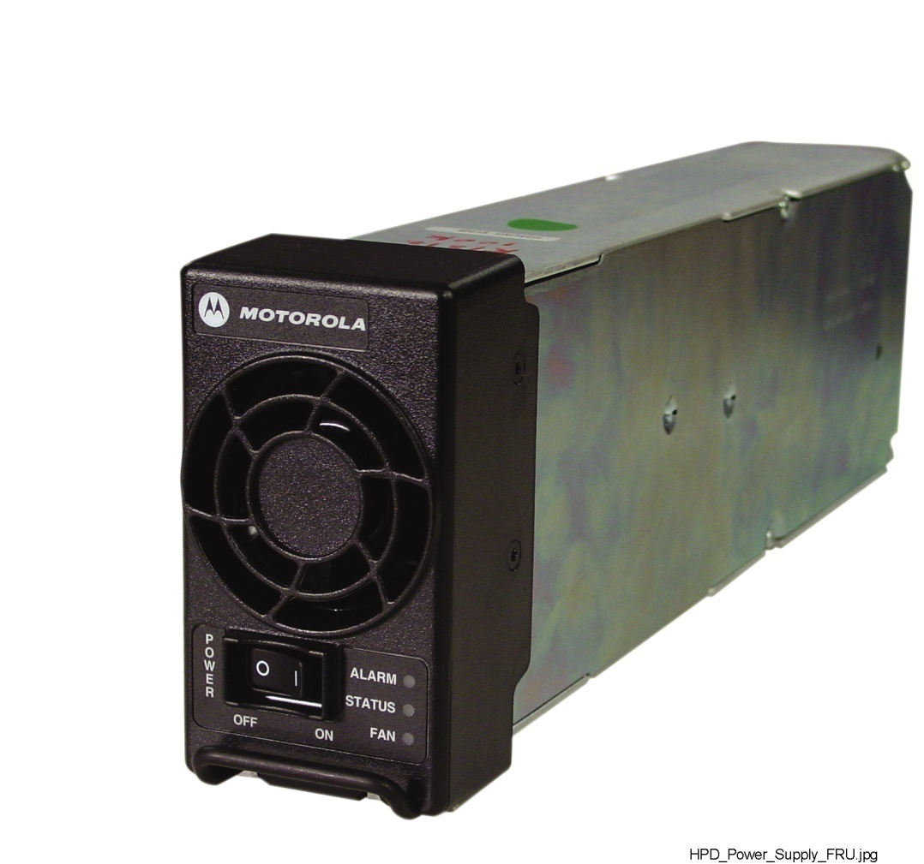
Fonte de Alimentação
Módulo de Fonte de Alimentação GTR 8000
Notes:
Instructor Guide
2-<number>
ASTRO® 25 Trunked IV&D System Release 7.4 Module 4: GTR 8000 Expandable Site Subsystem
GTR 8000 Expandable Site Subsystem Workshop
Instructor Notes:
The power supply module has three LEDs visible from the front panel. The color of all the LEDs must be observed in order to interpret its condition.
For example:
If the Alarm and Fan LEDs are red and the Status LED is Verde, the condition is “Lamp Test.”
If the Alarm LED is red, and the Fan and Status LEDs are not lit, the condition is “Power Supply Failure.”
If the Fan LEDs are red and the Status LED is Verde, the condition is “Power Supply fan Failure.”

Slide 38
Condições dos LEDs da Fonte de Alimentação
Condição | Ventilador | Estado | Alarme
Sem Potência
Teste de Leds | Vermelho | Verde | Vermelho
Ligado |  | Verde
Deteriorado |  | Verde | Vermelho (piscando)
Falha da Fonte de Alimentação |  |  | Vermelho
Falha do Ventilador da Fonte de Alimentação | Vermelho | Verde
Notes:
Instructor Guide
2-<number>
ASTRO® 25 Trunked IV&D System Release 7.4 Module 4: GTR 8000 Expandable Site Subsystem
GTR 8000 Expandable Site Subsystem Workshop

Slide 39
Equipamento e Ferramentas Requeridas
Caixa de Ferramentas Técnicas para troca da FRU
Pulseira anti-estática (ESD strap -Motorola P/N RSX4015A)
PC portátil com CSS e SWDL instalados
Cabo serial DM-9 direto
Cabo Ethernet
Chaves de fenda e phillips
Conjunto de pontas TORX
Notes:
Instructor Guide
2-<number>
ASTRO® 25 Trunked IV&D System Release 7.4 Module 4: GTR 8000 Expandable Site Subsystem
GTR 8000 Expandable Site Subsystem Workshop

